Slide 1
The Fundamentals

Slide 2
Learning outcomes
At the end of this chapter, students are expected to
Understand how internet works
Explain what a web server is and how it works
Explain what a web browser is and how it works
Become familiar with concepts of web hosting
Differentiate between Webpages, Websites and Web Apps
Understand Internet Protocols
Become familiar with HTTP
Learn how to use browser developer tools (lab session)

Slide 3
The internet
The internet is an international network of connected computers.
Internet is a cooperative effort governed by a system of standards and rules.
The purpose of connecting computers together is to share information and resources.
There are many ways information can be passed between computers, including
email (POP3/IMAP/SMTP),
file transfer (FTP),
secure shell (SSH)
Hyper text transfer (HTTP) etc.,
These standardized methods for transferring data or documents over a network are known as protocols.

Slide 4
The Web
The web (originally called the World Wide Web) is one of the ways information can be shared over the internet.
The web is unique in that it allows documents to be linked to one another via hypertext links
thus forming a huge “web” of connected information.
The web uses a protocol called HTTP (HyperText Transfer Protocol).
This acronym should look familiar because it is the first four letters of nearly all website addresses

Slide 5
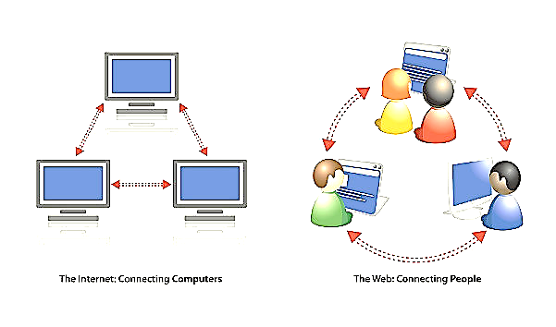
Internet vs WWW
The terms Internet and World Wide Web are often used without much distinction. However, the two things are not the same.
The world wide web, or web for short, are the pages you see when you're at a device and you're online
The Internet is a global system of interconnected computer networks.

Slide 6
Server
A web page becomes accessible when it is hosted on a web server.
"Hosting" means that all the web pages of a website and their supporting files are available on a specific computer.
Thus, a web server is a computer that hosts a website on the Internet.
There’s nothing special about the computers used as servers themselves.
The computers used can be anything from a high-powered Unix machine to a humble personal computer.
It’s actually the server software that makes it all happen.

Slide 7
Web server cont’d
The role of a server software is
to wait for a request of information, and
then to retrieve and send that information back as quickly as possible
There are many server software options, but the two most popular are Apache and Microsoft Internet Information Services (IIS).

Slide 8
Client
If the web server does the serving, the software that does the requesting is called the client
People use desktop browsers and mobile browsers as clients to access documents on the web
The most popular desktop browsers include Edge, Internet Explorer, Chrome, Firefox, Safari, and Opera.
These days, however, more than half of web traffic comes from mobile browsers on smartphones and tablets such as
Safari on iOS,
Chrome browsers on Android devices,
Opera Mini, and a myriad of other default and installable mobile browsers
Notes:
Browsers basically let you type any URL and also allow you to view pages

Slide 9
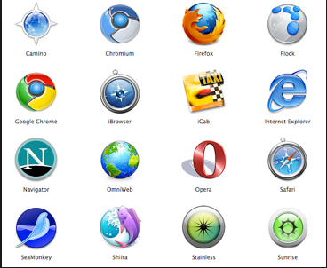
Web Browser
Web browser is a software application for retrieving, presenting and traversing information resources on the World Wide Web.
A browser's primary control is the address bar.
You enter a URL (Uniform Resource Locator) that describes to the browser where to find the item you want,
And the browser contacts the web server and requests the item which the server then sends back.

Slide 10
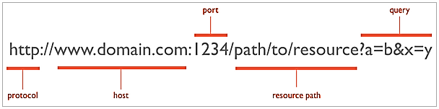
Web Page Addresses (URLs)
Every page and resource on the web has its own special address called a URL (pronounced “U-R-L,” not “erl”),
URL stands for Uniform Resource Locator.
Some URLs are short.
Others may look like several strings of characters separated by dots (periods) and slashes,
However, each part has a specific purpose.

Slide 11
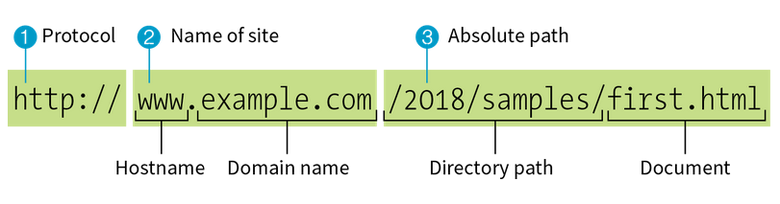
The Parts of a URL
A complete URL is generally made up of three components:
the protocol,
the site name, and
the absolute path to the document or resource,

Slide 12

http:// : The letters “HTTP” let the server know to use HyperText Transfer Protocol, or get the server into “web mode.”
www.example.com: This portion of the URL identifies the website by its domain name. The domain name is “example.com” .The “www.” part at the beginning is the particular hostname at that domain.
The hostname “www” has become a convention, but is not a rule. In fact, sometimes the hostname may be omitted. There can be more than one website at a domain (called subdomains). For example, there might also be “development.example.com,” “clients.example.com,” and so on.
/2018/samples/first.html : The words separated by slashes are the directory names, starting with the root directory of the host (as indicated by the initial /).

Slide 13
Ice breaker
Where is the absolute path in the following URL?
How does the server know which webpage to retrieve?
http://www.paradigm.com

Slide 14
Pointing to default files
Many addresses do not include a filename, but simply point to a directory, like this: http://www.paradigm.com
When a server receives a request for a directory name instead of a specific file, it looks in the given directory for a default document, typically named index.html
So when someone types the previous URLs into his browser, what he’ll actually see is this: http://www.paradigm.com/index.html
The name of the default file (also referred to as the index file) may vary, and depends on how the server is configured.
some servers use the filename default.html

Slide 15
Website, Webpage, Web App
A website is a group of globally accessible, interlinked web pages which have a single domain name. Examples ???
A webpage is part of a website
A webpage is a single document on the web which uses a unique URL
A web page is a text file that contains text, images, hyperlinks, and sound
Web Apps are Internet-enabled apps that are accessed through a web browser. Therefore, you don’t require to download or install them. Examples ??

Slide 16
Network Architecture of the web

Slide 17
Client-Server Architecture
The Web is an example of a system that uses client-server architecture.
Network Architecture is the way network services and devices are structured together to serve the connectivity needs of client devices and applications.
In client-server architecture every process or computer in the network functions as a server or client.
The web consists of web servers, which are computers with information to provide, and web clients (aka, browsers), which are consumers of information.
Do you know of any other kind of network architecture??

Slide 18
Client-Server Architecture Cont’d
Client – The client can be any computer that requests something from the server. For example – when visiting any website we request a webpage using a browser. (here we act as a client)
Server – On the other hand, the server is the computer that is designed to serve the requests to the client. For the same example, the client asks for a webpage then the server responds with the webpage to the client. The server
Stores and protects data
Processes requests from clients
Is always on

Slide 19
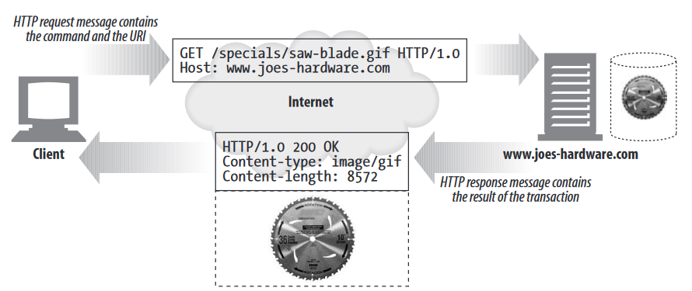
Overview of HTTP protocol
HTTP is the underlying protocol used by the World Wide Web.
Notes:
HTTP is the set of rules that web browsers and servers use to communicate with each other on the internet
There are specific commands that the browser (client) can use to ask the server to do something
There are standardized codes the server sends back to the client to tell it the result of its request

Slide 20
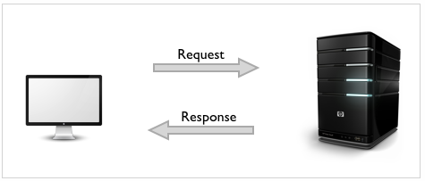
Overview of HTTP protocol
Communication between a host and a client occurs, via a request/response pair. For example,
When you type a URL into your web browser and press Enter, your browser sends a request called an HTTP request to the web server that hosts the website you want to visit.
The server then sends back an HTTP response, which contains the data for the web page you requested for.

Slide 21
Cont.…..
HTTP methods/ verbs/HTTP request messages
They specify the action that should be performed on the host.
GET: fetch an existing resource. The URL contains all the necessary information the server needs to locate and return the resource.
POST: create a new resource. POST requests usually carry a payload that specifies the data for the new resource.
PUT: update an existing resource. The payload may contain the updated data for the resource.
DELETE: delete an existing resource.
Notes:
The method tells the server what action to perform (fetch a web page, run a gateway program, delete a file, etc.)
Request messages request an action from a web server.

Slide 22
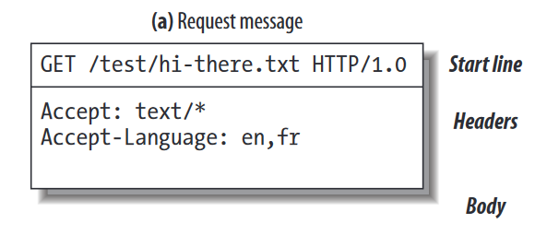
Example

Slide 23
Cont.…..
Status Codes / HTTP response messages
With URLs and verbs, the client can initiate requests to the server. In return, the server responds with status codes and message payloads
2xx: Successful
This tells the client that the request was successfully processed.
3xx: Redirection
This requires the client to take additional action.
4xx: Client Error
These codes are used when the server thinks that the client is at fault, either by requesting an invalid resource or making a bad request.
5xx: Server Error
This class of codes are used to indicate a server failure while processing the request.
Notes:
Every HTTP response message comes back with a status code.
The status code is a three-digit numeric code that tells the client if the request succeeded, or if other actions are required.

Slide 24
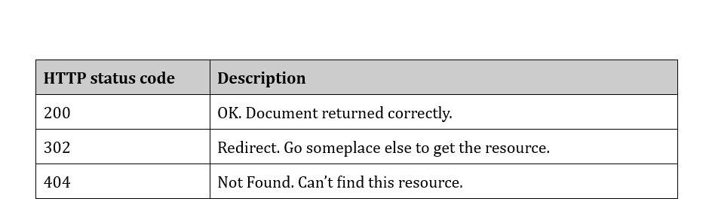
Every HTTP response message comes back with a status code
The status code is a three-digit numeric code that tells the client if the request succeeded, or if other actions are required.

Slide 25
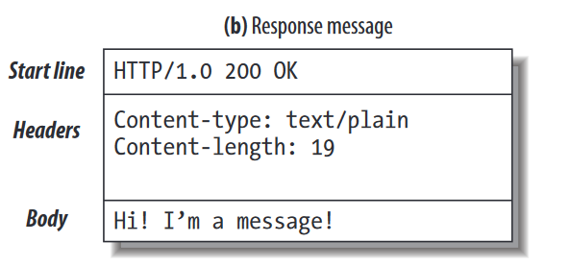
Example

Slide 26
TCP/IP protocol
Client/server messages are exchanged via the TCP/IP protocol until the connection is complete.
A network protocol is a set of established rules that specify how to format, send and receive data.
Network protocols are like a common language for computers.
The main function of TCP/IP is that it governs how information is sent and received in the form of packets between source and destination.
Notes:
Just about all of the world’s HTTP communication is carried over TCP/IP
TCP Vs IP
Let’s say you’re trying to stream a video from a website.
When you click on the video, your web browser sends an HTTP request to the web server that hosts the video. The server then sends back an HTTP response that contains the video data.
However, the video file is typically too large to be transmitted all at once.
Instead, the video is broken up into smaller “packets” of data and transmitted over the network one at a time.
This is where TCP comes in. TCP ensures that each packet of data is transmitted correctly and reliably.

Slide 27
TCP/IP protocol
TCP/IP is a two-layer program.
Transmission Control Protocol and Internet Protocol (TCP/IP) are two different communication protocols.
The higher layer, Transmission Control Protocol (TCP) splits a message to packets which will be transmitted across the internet
whereas The lower layer, Internet Protocol (IP) is accountable to address every packet hence forwards it to the exact destination.

Slide 28
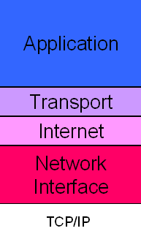
The TCP/IP model is divided into four different layers (reading assignment): 0
Application layer: In a web-based client-server architecture, the client (browser) sends requests to a web server over the HTTP or HTTPS protocol.
other protocols: HTTP, FTP, SMTP
Transport layer: Once the application-layer data (e.g., an HTTP request) is ready, it is passed down to the transport layer. Here, the TCP protocol takes over to ensure reliable data transmission by establishing a connection, breaking data into packets, and reassembling it at the destination.
Main protocols: TCP, UDP
Notes:
the flow of data goes from top to bottom when data is being transmitted from the sender side. In the case of data being received, the layers of the model work in reverse order.
Transport layer: Ensures that packets are delivered to the correct destination in the correct order.

Slide 29
The TCP/IP model is divided into four different layers (reading assignment): 0
Internet layer: At this layer, the IP protocol handles addressing and routing, making sure that data packets travel across the network to the correct destination. Uses IP addresses to identify devices on the network.
Main protocol: IP
Network Access layer: Transmits packets over the physical network media.
Examples protocols: Ethernet, Wi-Fi, cellular data
Notes:
the flow of data goes from top to bottom when data is being transmitted from the sender side. In the case of data being received, the layers of the model work in reverse order.

Slide 30
Concerns in contemporary web environment

Slide 31
Concerns in contemporary web environment
Web designers never know exactly how the pages they create will be viewed.
They don’t know which of the dozens of browsers might be used,
whether it is on a desktop computer or something more portable,
how large the browser window will be,
what fonts are installed,
whether functionality such as JavaScript is enabled,
how fast the internet connection is,
whether the pages are being read by a screen reader, and so on.

Slide 32
Concerns in contemporary web environment
The following are methods for coping with the inescapable element of the Unknown when creating a website :
Web standards
Progressive enhancement
Responsive Web Design
Accessibility
Site performance

Slide 33
Web standards
Web standards are specifications for web designers and developers to follow, ensuring that the websites they build are usable and accessible to all, regardless of the device they use to access the Internet.
The W3C is the best known web standards body, but there are others such as,
ECMA (who publish the standard for ECMAScript, which JavaScript is based on)
Sticking with web standards is your primary tool for ensuring your site is consistent on all standards-compliant browsers
Notes:
Web standards are created by institutions that invite groups of people from different technology companies to come together and agree on how the technologies should work in the best way to fulfill all of their use cases.

Slide 34
Progressive enhancement
Progressive enhancement means to start with a baseline experience that makes core functionality available to even the most rudimentary browsers first.
Then overlaying more advanced features (features that aren’t really critical to the brand or message) for the browsers that can handle them.
Such as, animation or
wrapping text around images in interesting shapes,
Notes:
You have to be mindful of styling the baseline experience first, then adding improvements once the minimum requirements are met.

Slide 35
Progressive enhancement
For example,
there are differences in how browsers handle JavaScript (particularly on non-desktop devices), so some users opt to turn JavaScript off completely.
Therefore, according to progressive enhancement principles, we need to make sure basic functionality, such as
linking from page to page or data submission via forms, is unbroken even when JavaScript is off.

Slide 36
Responsive Web Design
In 2016, mobile internet usage surpassed desktop usage.
Which means that the percentage of web traffic that comes from devices other than desktop browsers is larger.
Accustomed to designing exclusively for large desktop screens, web designers were unclear about how to accommodate screens that are much smaller.
Moreover, another majority accesses the web from a number of different platforms (phone, tablet, computer) over the course of the day.
And still expect to have a similar experience regardless of how they access your site.

Slide 37
Responsive Web Design
Responsive Web Design (RWD) is a strategy for providing appropriate layouts to devices based on the size of the viewport (browser window).
The key to Responsive Web Design is serving a single HTML document to all devices, but applying different style sheets based on the screen size in order to provide the most optimized layout for that device.
For example, when a page is viewed on a smartphone, it appears in one column with large links for easy tapping.
But when that same page is viewed on a large desktop browser, the content rearranges into multiple columns with traditional navigation elements.

Slide 38
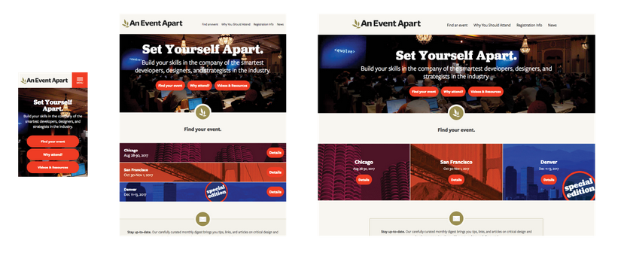
Example of a responsive site that adapts to fit small, medium, and large screens and all sizes in between.

Slide 39
Accessibility
So far, we’ve only addressed visual browsers controlled with mouse pointers or fingertips.
It is critical, however, to keep in mind that people access the web in many different ways—
with a keyboard, mouse, voice commands, screen readers, Braille output, magnifiers, joysticks, foot pedals, and so on.
Web designers must build pages in a manner that creates as few barriers as possible to getting to information, regardless of the user’s ability and the device used to access the web.
In other words, you must design for accessibility.
Notes:
Accessible sites are also more effectively indexed by search engines such as Google. Making your site accessible is well worth the extra effort.

Slide 40
Site performance
Everyone knows how frustrating it is to wait for a web page to fully display.
Studies show that users expect a site to load in under two seconds, and nearly a third of your audience will leave your site for another if it doesn’t.
Furthermore, those people aren’t likely to come back.
Google has added site speed to its search algorithm, so if your site is a slow, it’s not likely to show up in the first screen of results.
There are many things you can do to improve the performance of your site, and they fall under two broad categories:
limiting file sizes and
reducing the number of requests to the server

Slide 41
Things you can do to improve the performance of your site
Optimize images so they are the smallest file size possible without sacrificing quality.
Streamline HTML markup, avoiding unnecessary levels of nested elements.
Minimize HTML and CSS documents by removing extra character spaces and line returns.
Keep JavaScript to a minimum.
Reduce the number of times the browser makes requests of the server (known as HTTP requests).

Slide 42
Takeaway question
List two unknown factors you need to consider when designing and developing a site.

Slide 43
End of chapter one

